Slide 1

Virtual Mouse (A.I) Project Presentation 06/05/2023
Project(IAI-851)
BACHELOR OF TECHNOLOGY (CSE) A.I (i-Nurture)
Project Guide:
Mr. Sudhanshu Kumar
Siddharth Singh (TCA1960007)
Nirdesh Kumar (TCA1960008)
Mohd.Suhel (TCA1960004)
Shruti Sharma (TCA1960005)
FACULTY OF ENGINEERING & COMPUTING SCIENCES
TEERTHANKER MAHAVEER UNIVERSITY, MORADABAD

Slide 2

Team Details
Student Name | Role
Siddharth Singh | Implementation
Nirdesh Kumar | Idea, Testing
Mohd Suhel | Documentation
Shruti Sharma | Error Handling
2

Slide 3
Project Brief
As computer technology continues to develop, people have smaller and smaller electronic devices.
Increasingly we are recognizing the importance of human computing interaction (HCI), and inparticular vision-based gesture and object recognition.
In our project, we propose a novel approach that uses a video device to control the mouse system(Mouse tasks).
We employ several image processing algorithms to implement this.
3

Slide 4
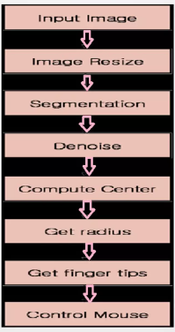
Methodologies
4

Slide 5
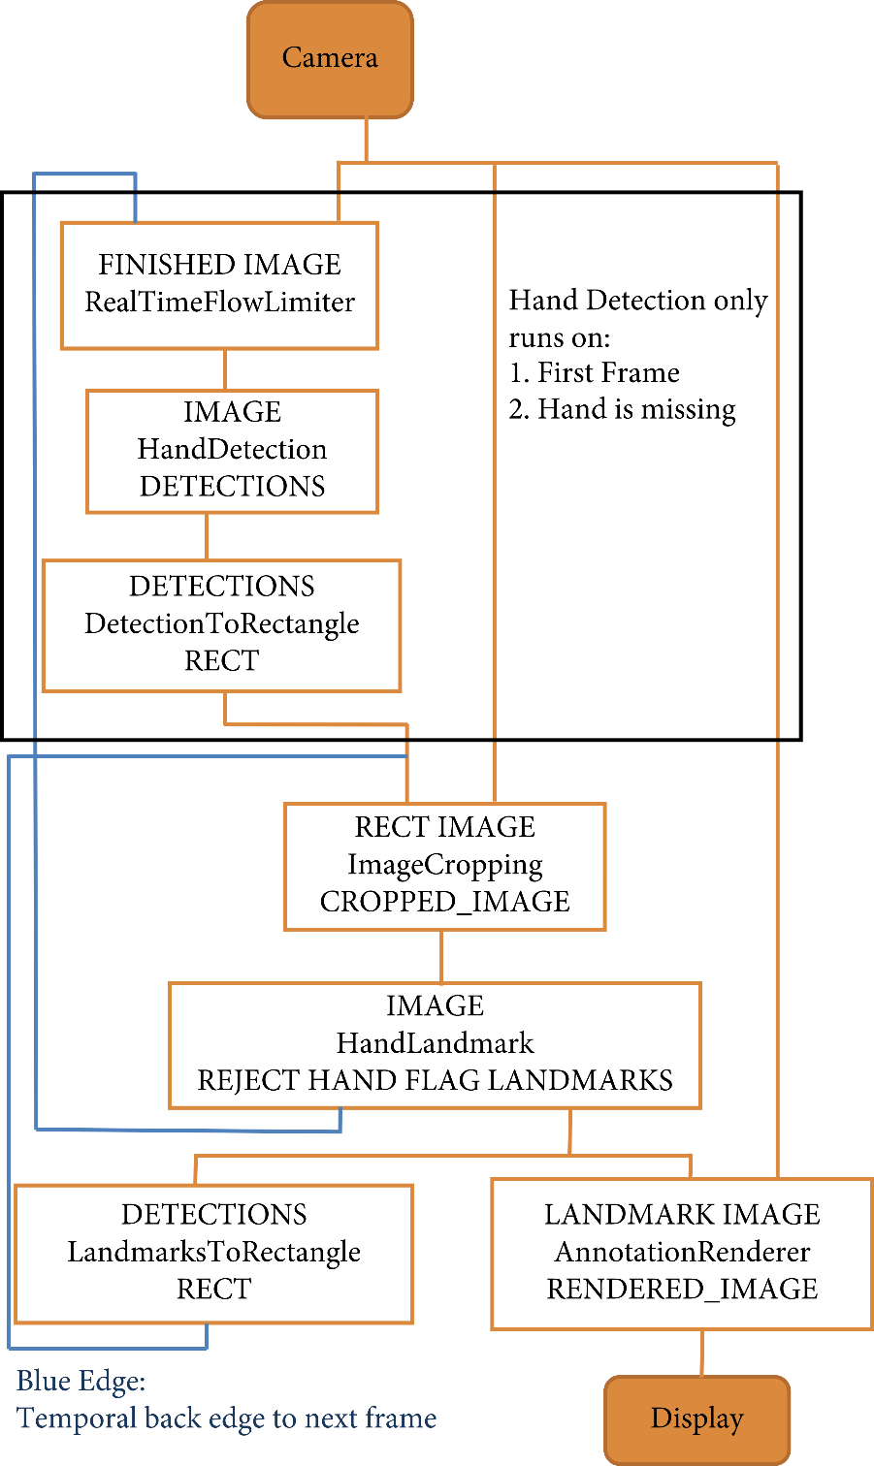
Context Diagram
5

Slide 6
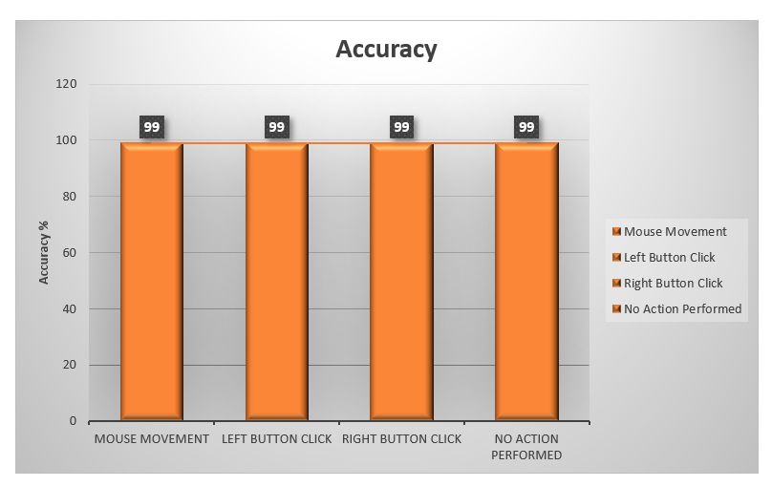
Entity Relationship Diagram (ERD)
6

Slide 7
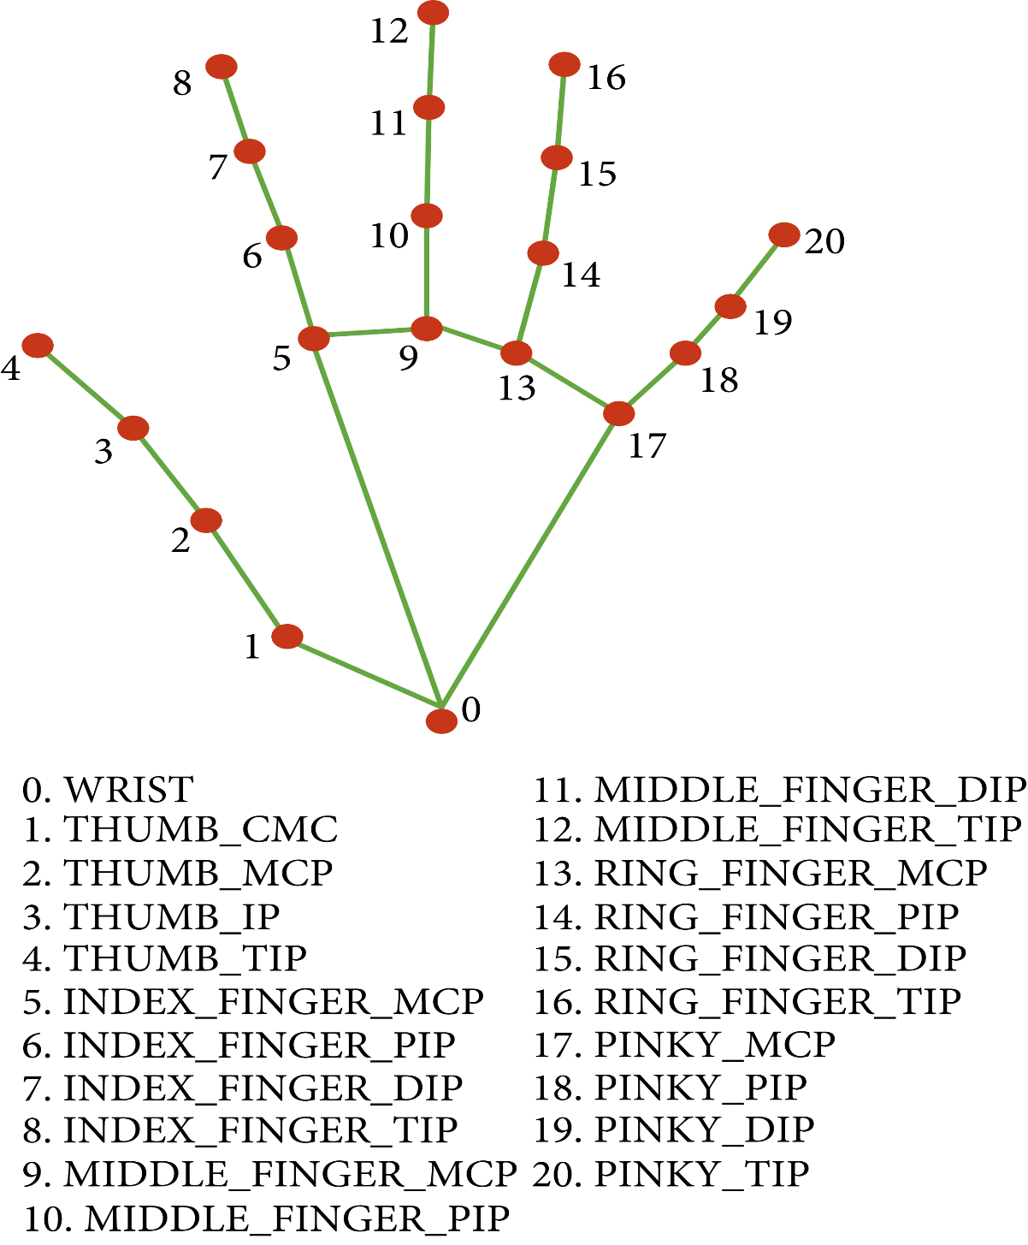
Use Case Diagram
7

Slide 8
\
Advantage of The Project
The main advantage of using hand gestures is to interact with computer as a non-contact human computer input modality.
Reduce hardware cost by eliminating use of mouse.
Convenient for users not comfortable with touchpad.
The framework may be useful for controlling different types of games and other applications dependent on the controlled through user defined gestures.
8

Slide 9
\
Limitation of The Project
The present application though seems to be feasible and more user friendly.
An attempt to make the input modes less constraints dependent for the users hand gestures has been preferred.
Another important aspect for the related development could be design of an independent gesture vocabulary framework.
The colour detection algorithm can cause detection problem if another coloured rubber in working domain of webcam.
9

Slide 10
\
Conclusion of The Project
We are developing a system to control the mouse cursor using a real-time camera.
This system is based on computer vision algorithms and can do all mouse tasks.
However, it is difficult to get stable results because of the variety of lighting and skin colors of human races.
This system could be useful in presentations and to reduce work space.
Features such as enlarging and shrinking windows, closing window, etc. by using the palm and multiple fingers.
10

Slide 11
References :-
S. U. Dudhane, “Cursor control system using hand gesture recognition,” IJARCCE, vol. 2, no. 5, 2013.
K. P. Vinay, “Cursor control using hand gestures,” International Journal of Critical Accounting, vol. 0975–8887, 2016
L. Thomas, “Virtual mouse using hand gesture,” International Research Journal of Engineering and Technology (IRJET, vol. 5, no. 4, 2018.
P. Nandhini, J. Jaya, and J. George, “Computer vision system for food quality evaluation—a review,” in Proceedings of the 2013 International Conference on Current Trends in Engineering and Technology (ICCTET), pp. 85–87, Coimbatore, India, July 2013.
J. Jaya and K. Thanushkodi, “Implementation of classification system for medical images,” European Journal of Scientific Research, vol. 53, no. 4, pp. 561–569, 2011.
J. T. Camillo Lugaresi, “MediaPipe: A Framework for Building Perception Pipelines,” 2019, https://arxiv.org/abs/1906.08172.
J. Jaya and K. Thanushkodi, “Implementation of classification system for medical images,” European Journal of Scientific Research, vol. 53, no. 4, pp. 561–569, 2011.
11

Slide 12
Thank You
12

